Slide 1
TRAVEL MODULE
101

Slide 2
Things Needed for Travel Request
Budget Code
Registration/Registration Attachment
Lodging Info/Lodging Attachment
Vehicle Info/Vehicle Attachment (If Applicable)
Airline/Info/ Airline Attachment (If Applicable)

Slide 3
Travel
Plan Early
Travel Request must be submitted at least 14 days in advance

Slide 4
Login
Two ways to Login
TEAMS Home Page
Employee Service Center – Designed for anyone to complete their Travel Request and Expense Report anytime, anywhere.

Slide 5
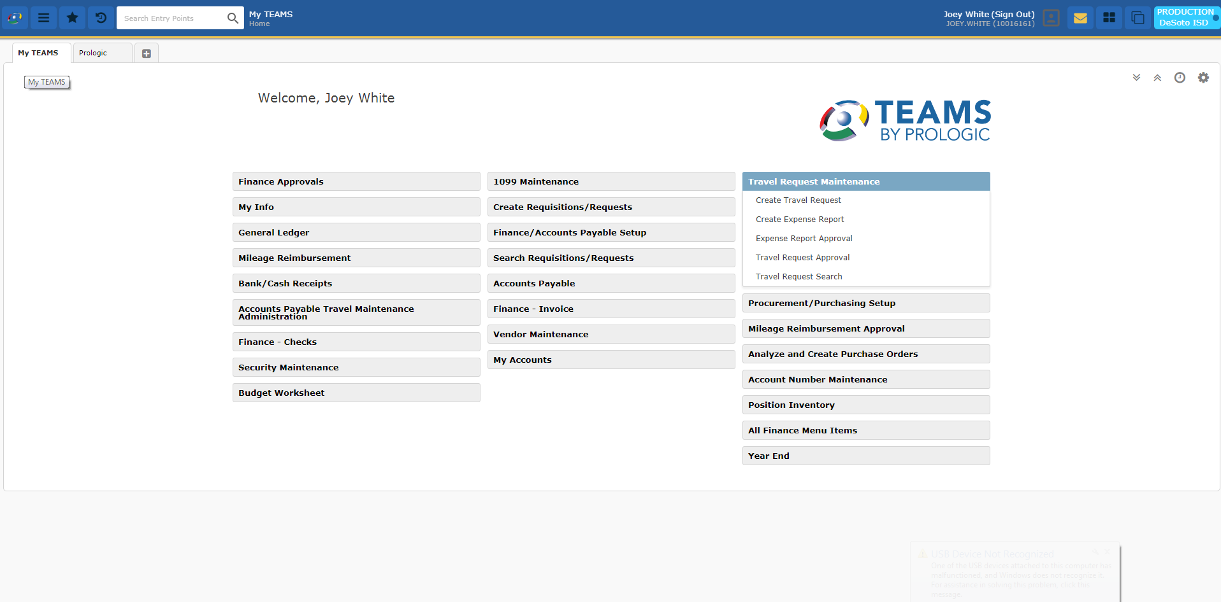
TEAMS Home Page

Slide 6
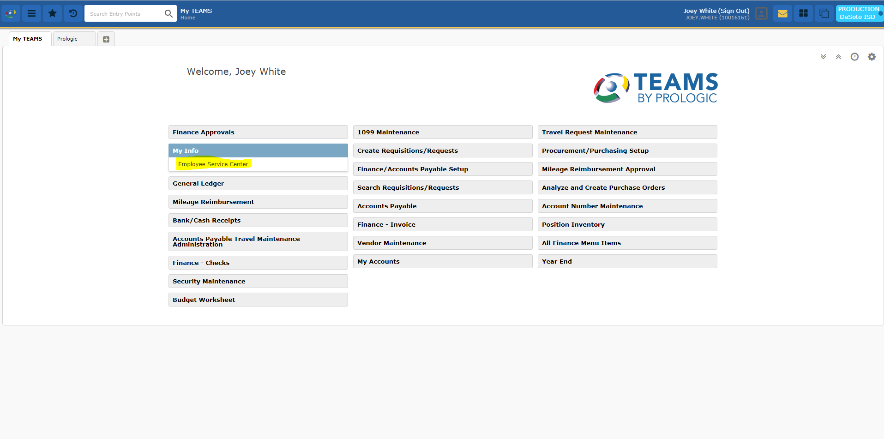
Employee Service Center

Slide 7
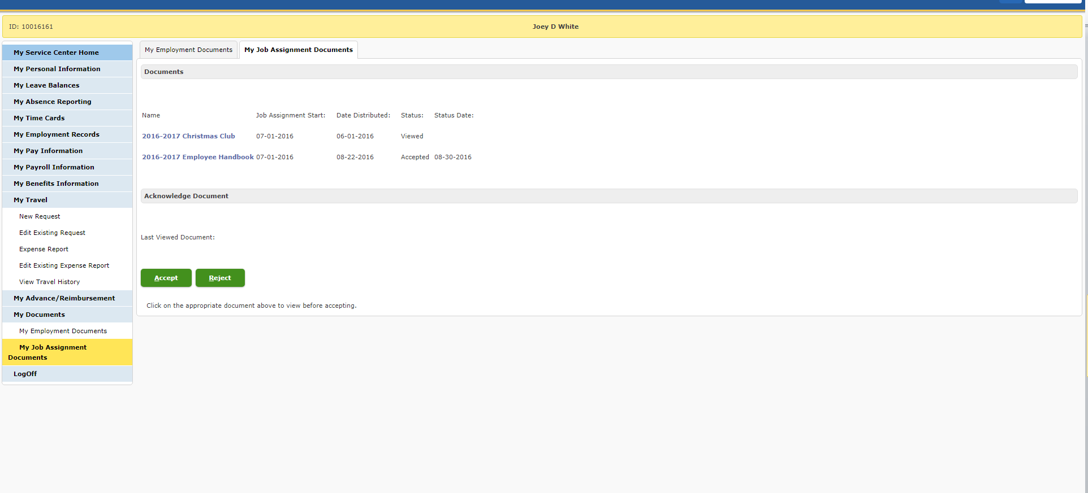
My Travel

Slide 8
General

Slide 9
Registration

Slide 10
Lodging
**Please refer to GSA.gov for per diem**

Slide 11
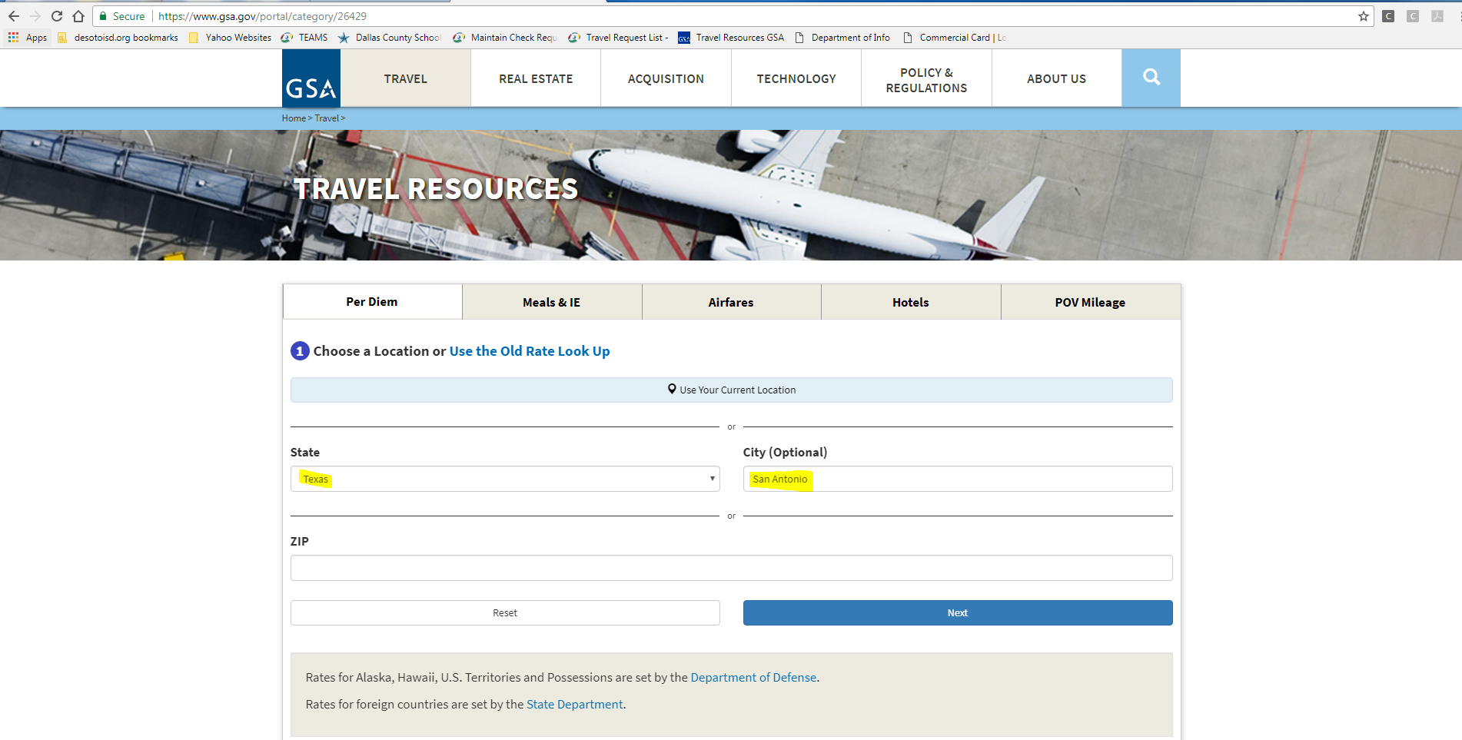
GSA Rate

Slide 12
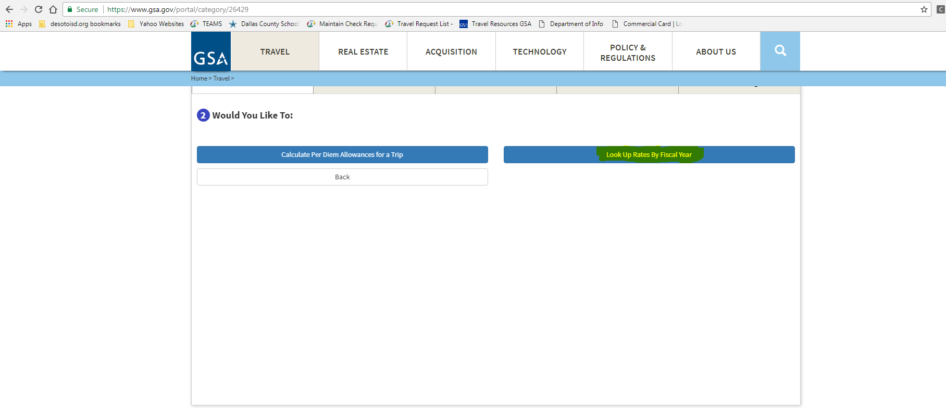
GSA Rate Continued

Slide 13
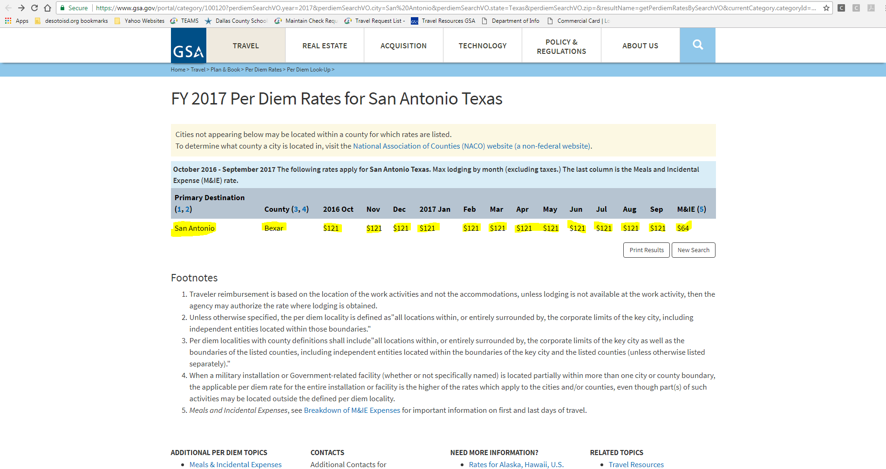
GSA Rate Continued

Slide 14
Vehicle

Slide 15
Airline

Slide 16
Other Expense

Slide 17
Submit

Slide 18
Things you should know before completing your Expense Report
Expense Reports are due no later than 5 days after travel has been taken. If not completed in within those 5 days, ALL reimbursement will be forfeited.
Must have registration attachment or completion certificate from conference
Must have Folio hotel checkout receipt
If using personal vehicle, must have Mapquest attachment for mileage from 200 East Belt Line Road Desoto, Texas to the destination of conference or training.
Airline receipt (If Applicable)
Must have itemized meal receipts (NO EXCEPTIONS)
If you have Other Expenses such as baggage, parking, you must have attachments to show you paid for baggage, parking, etc.

Slide 19
CREATE EXPENSE REPORT

Slide 20
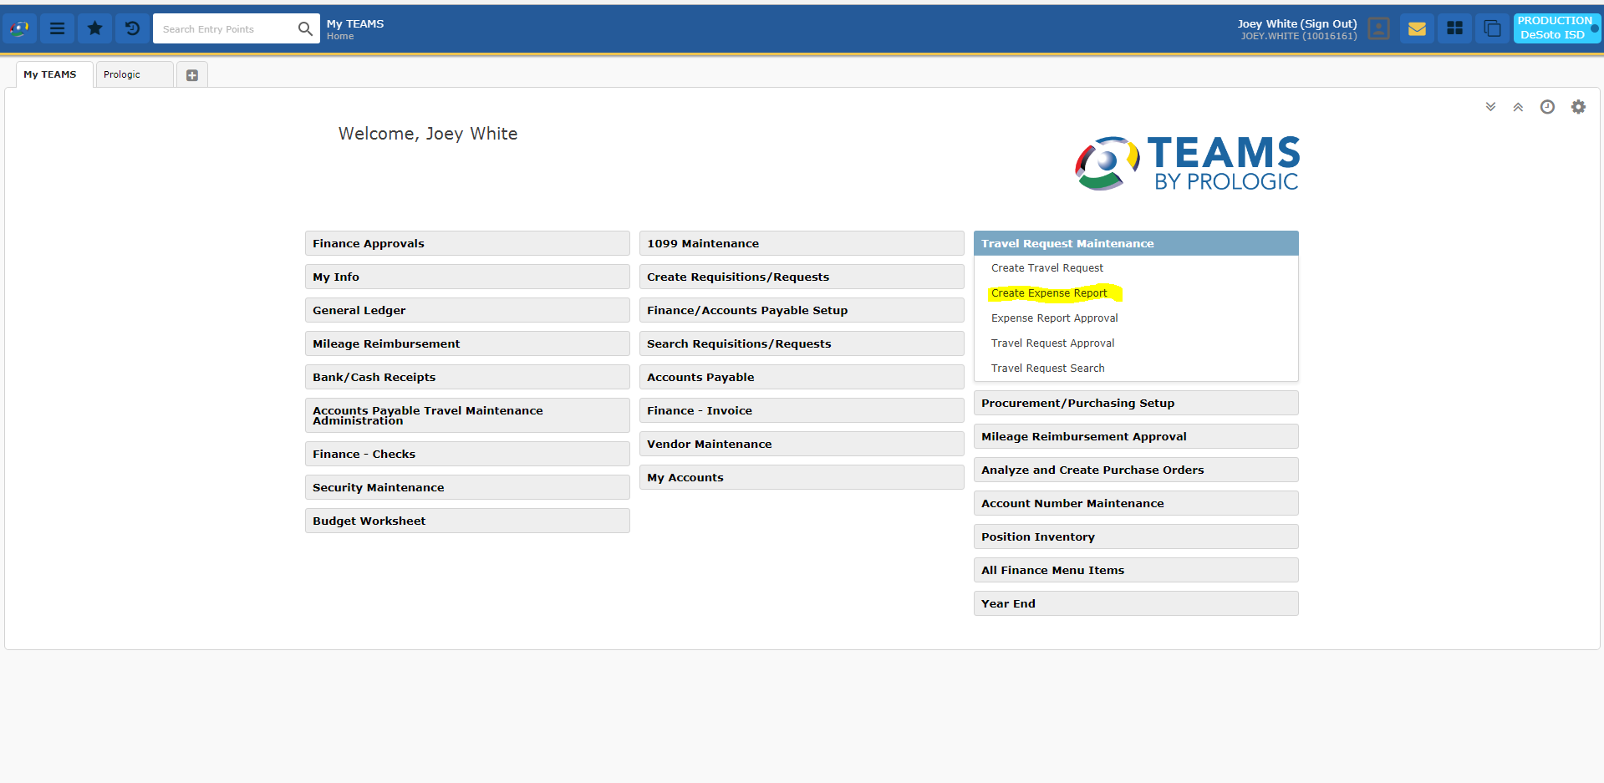
TEAMS Home Page

Slide 21
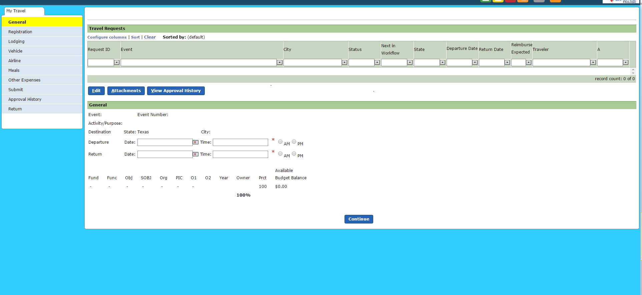

Slide 22
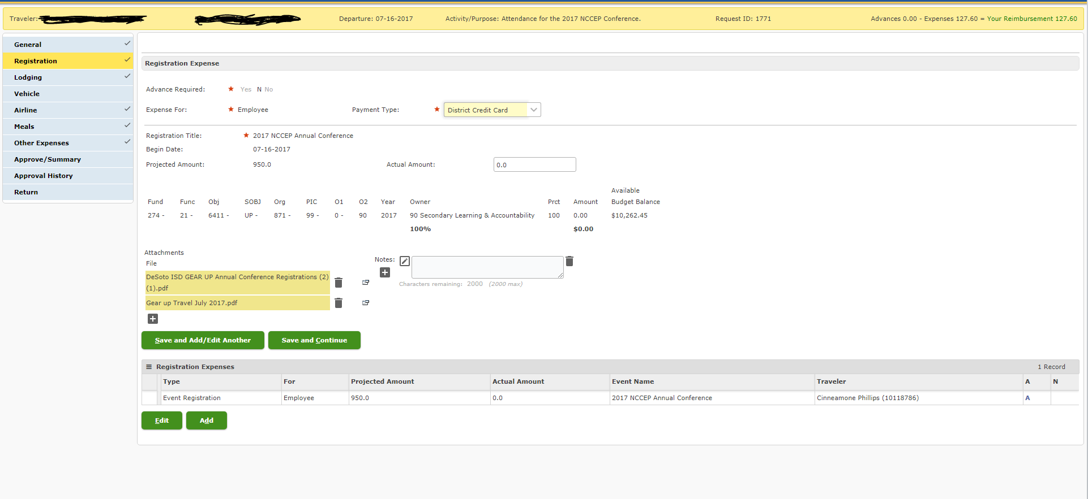
Registration Expense

Slide 23
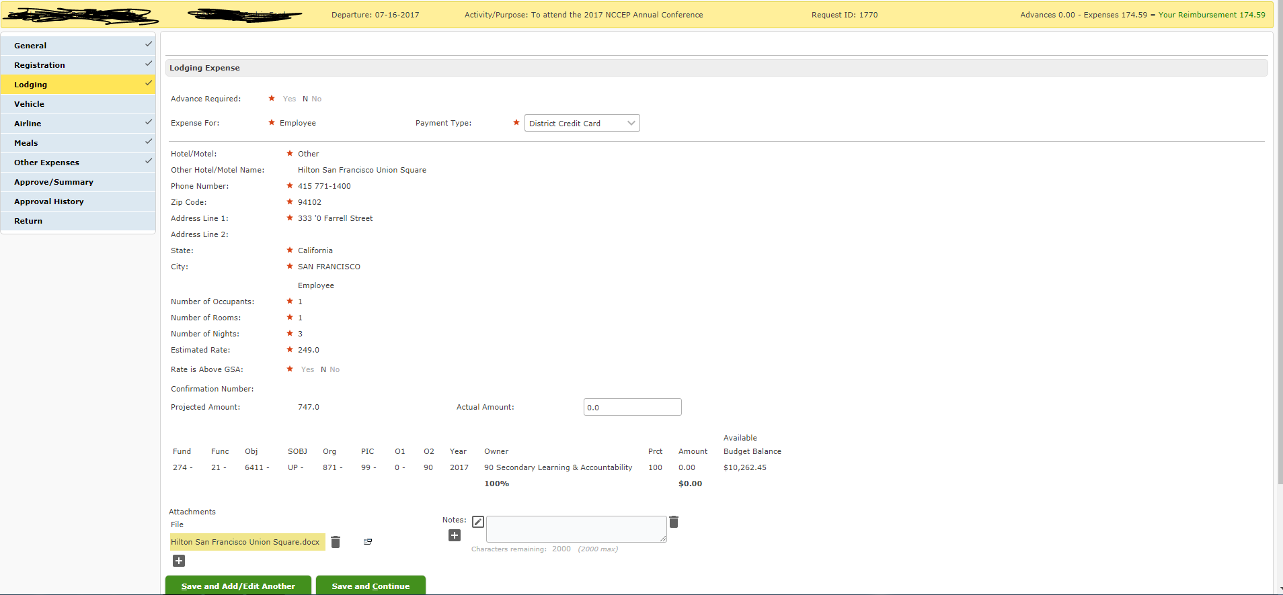
Lodging Expense

Slide 24
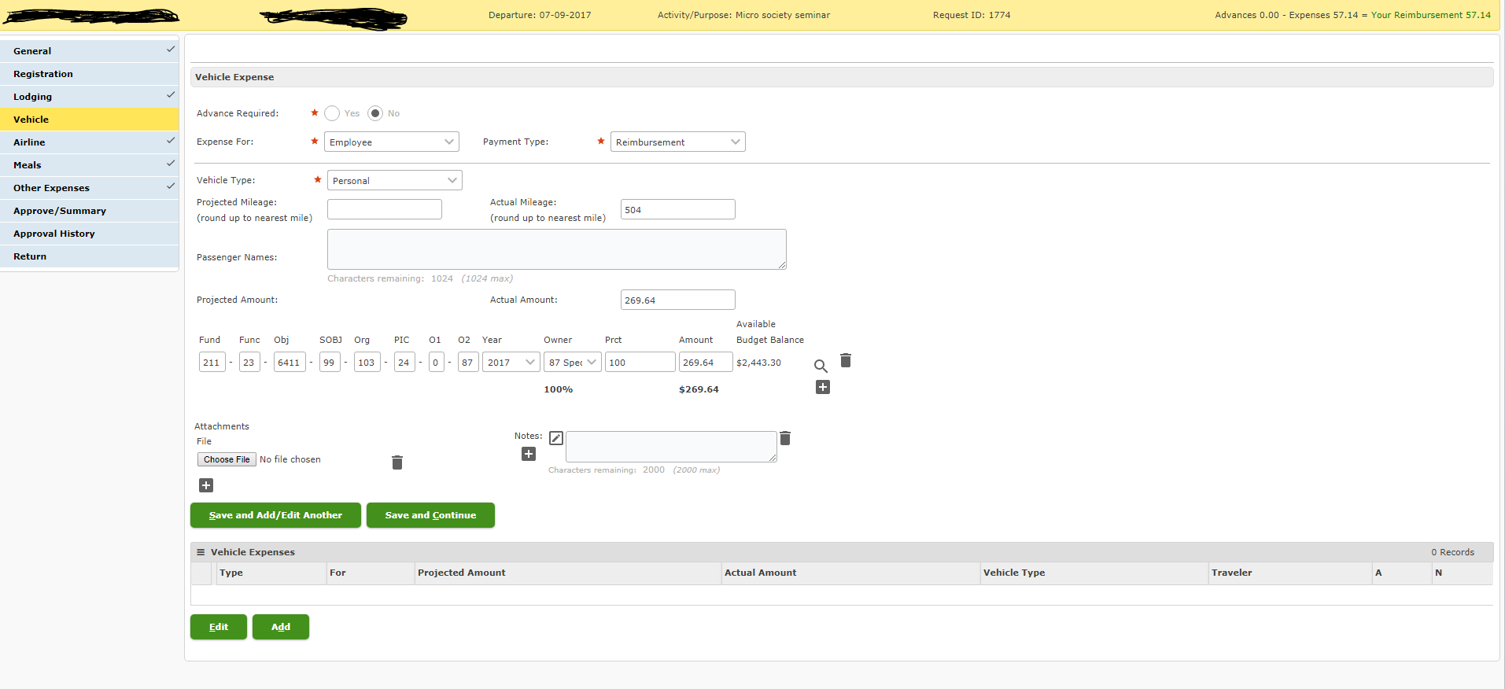
Vehicle Expense

Slide 25
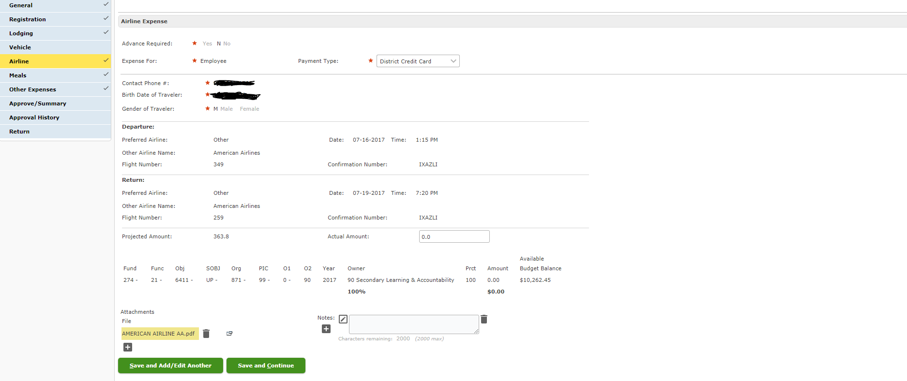
Airline Expense

Slide 26
Meal Expense

Slide 27
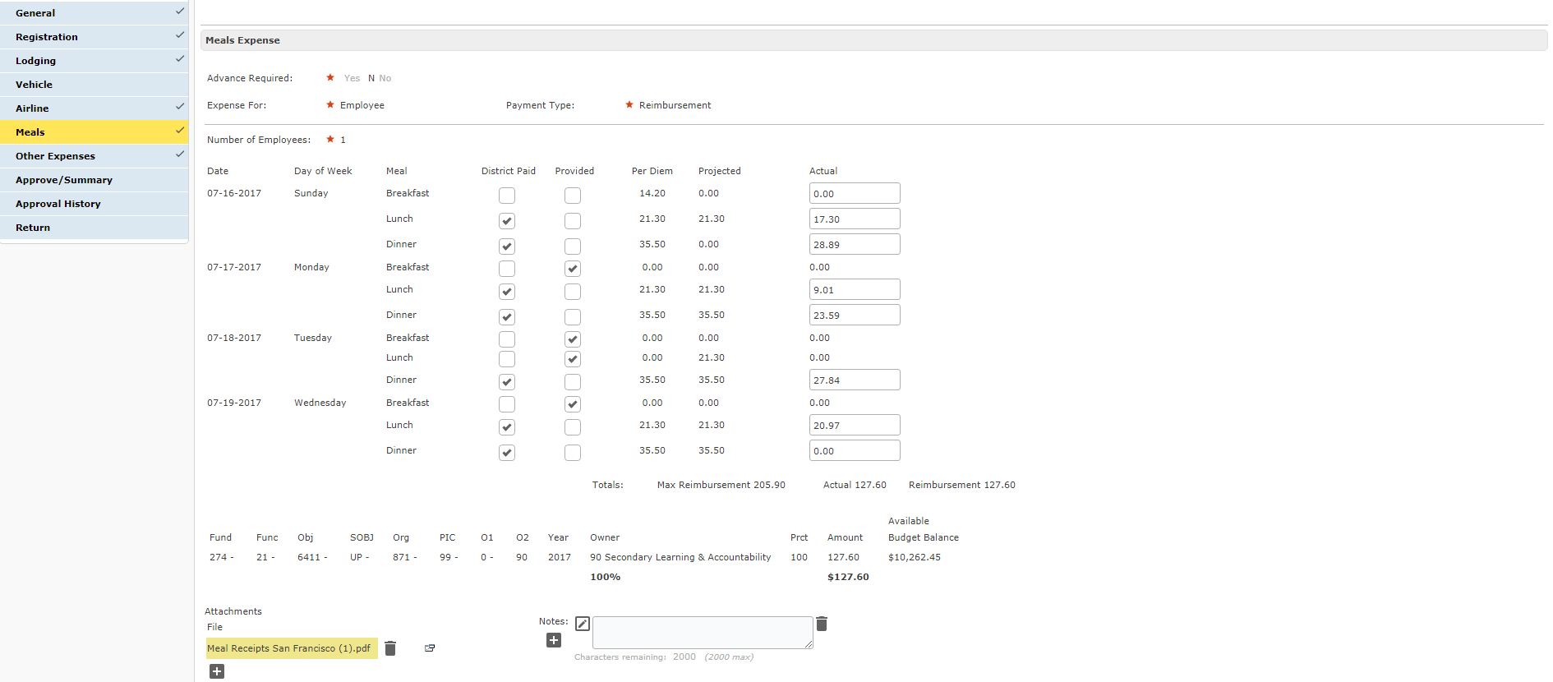
Meal Expense Continued

Slide 28
GSA Meal Breakdown

Slide 29
GSA Meal Breakdown Continued

Slide 30
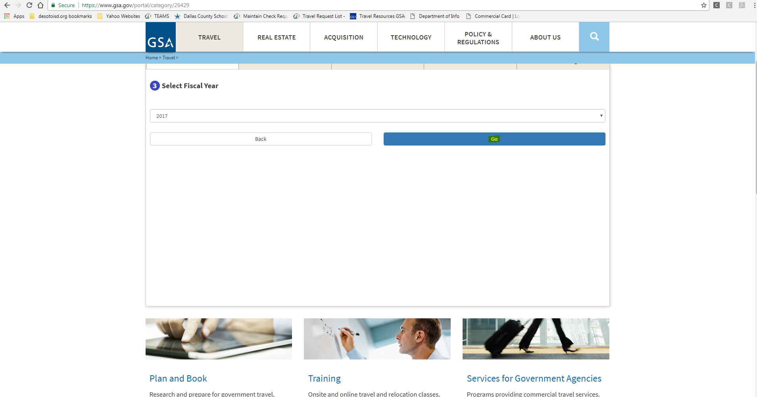
GSA Meal Breakdown Continued

Slide 31
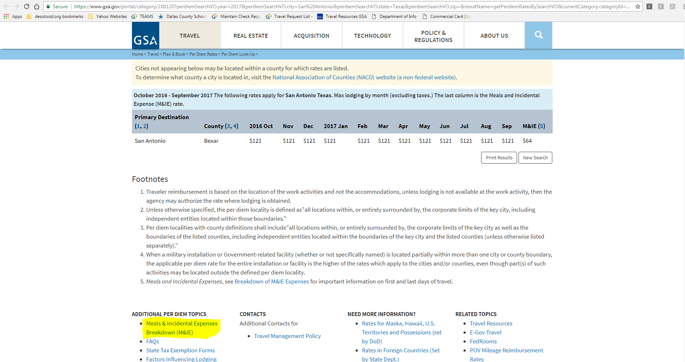
GSA Meal Breakdown

Slide 32
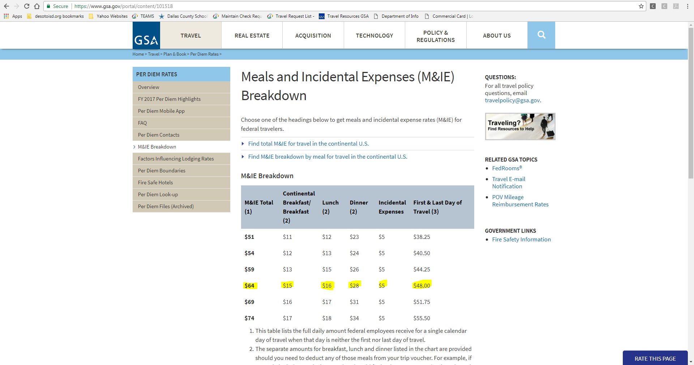
GSA Meal Breakdown Continued

Slide 33
Other Expenses

