Slide 1
DeSoto ISD – Finance Department Professional Development
Time Card Approval

Slide 2
Business and Financial Services Organizational Structure
Director, Business and
Financial Services
Controller
Gisselle Rivera-Franco
Administrative Assistant
Andrea Hall
Financial & Accounting System Clerks
Elpidia Diaz
Payroll & Benefits Specialist's
Tracie Cook
Loran Butler
Crystal Reed

Slide 3
Time Card Approval

Slide 4
Time Card Approvers/Managers Responsibility
Train Employees how to clock in and out
Coach/report abusers (those that are not clocking in/out daily) to the appropriate Administrator
Require Employees to clock in no matter the time of arrival (for editing purposes) and clock out

Slide 5
Time Card Verification
Time clock Punch Records need to be verified DAILY.
In TEAMS go to Time Card Approval > Punch Verification.
The Punch Verification page is used to review, edit and verify time clock punches and absences.
Real time punches can be viewed on this page as they are entered on the time clock. Same day editing, adding and adjusting of punches.
It is very important to remember that employees cannot approve their time card in the Employee Service Center until the Time Clock Manager verifies and processes the punch records. Once punch records have been verified and processed, then the time cards are built for the employees and final approvers.

Slide 6
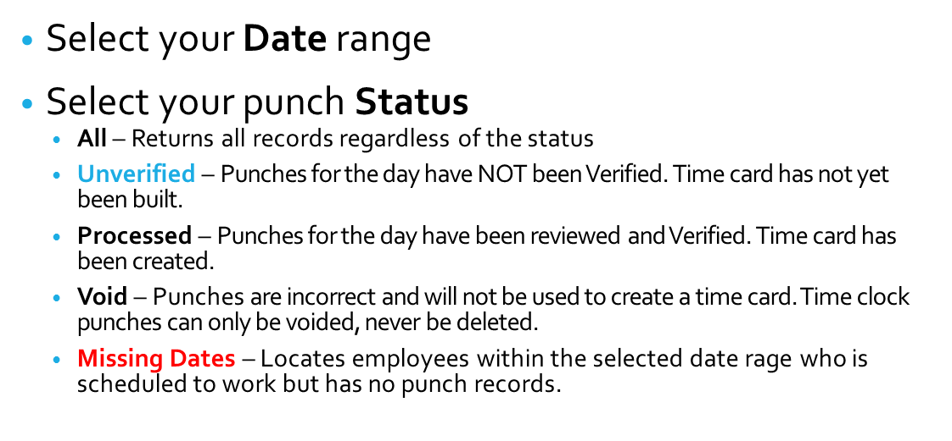
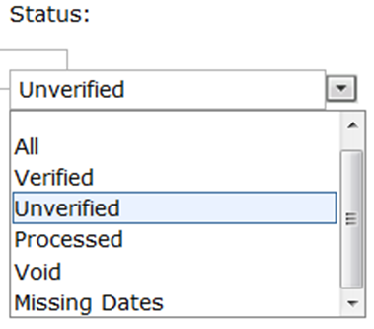
Time Card
Punch Verification Tab
Status Definition
Time Card Verification
Time Card Verification

Slide 7
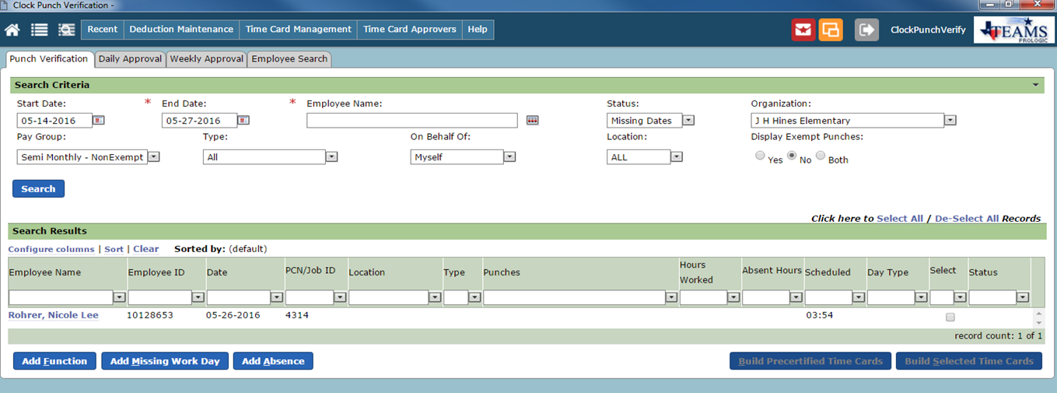
Time Card
Punch Verification Tab
Status Missing Dates
Missing Dates – indicates an employee has scheduled hours but has not clocked in. This is a useful tool to verify if an employee needs to report an absence in the Employee Service Center

Slide 8
Time Card
Punch Verification Tab
Status – Missing Dates Example
Missing date of 5/8/17- Employee did not punch in/out on that day
Verify if absence reported using the Employee Search Tab
No absence reported

Slide 9
Time Card
Punch Verification Tab
Status – Missing Dates Example
Filtering by Function

Slide 10
Time Card
Search Results
Hours Worked Error Indicator
ERROR:
In this example a punch in or out is
MISSING.

Slide 11
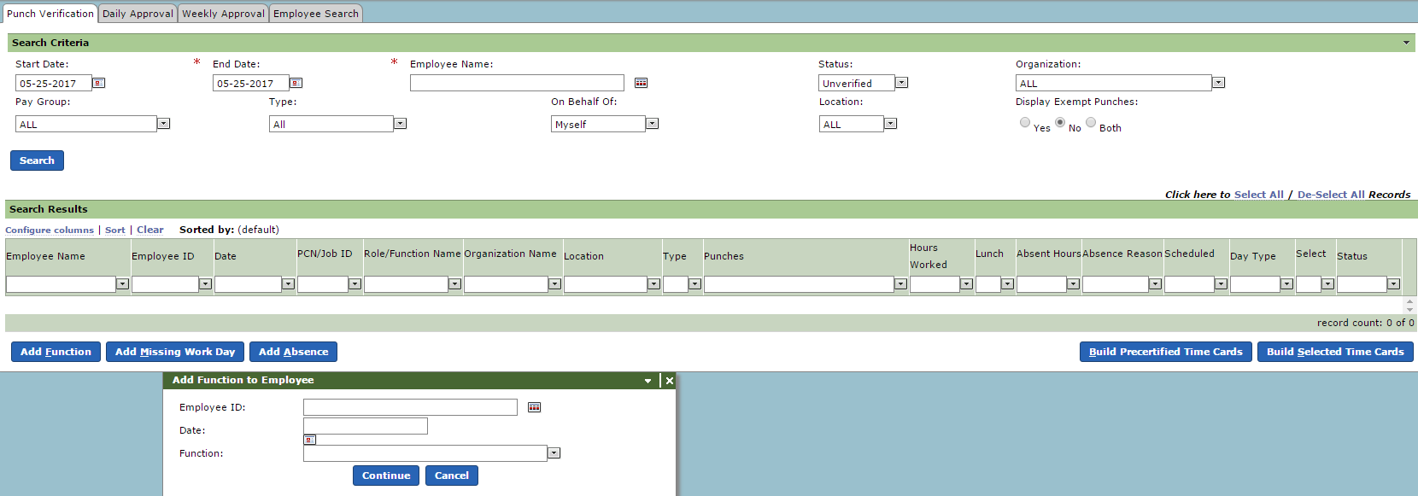
Add a Function to a Time Card
To add a Function:
Select Punch Verification tab / Click Add Function (it is not necessary to complete the information in search criteria)
Note:
If an employee’s name is highlighted prior to the selecting the Add Function button the Employee ID and Date fields will pre-populate.
Select the Button Add function
Complete the employee ID
Date
Function: by using the title name of the function, not the function number

Slide 12
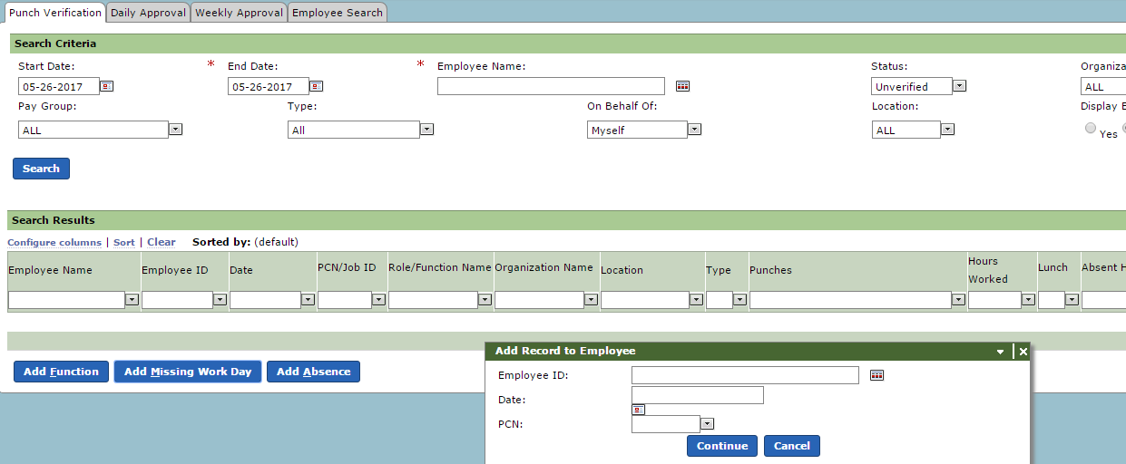
Add A Missing Day To A Time Card
To add Missing Work Day:
Select Punch Verification tab / Click Add Missing Work Day (it is not necessary to complete the information in search criteria)
Note: If an employee’s name is highlighted prior to the selecting the Add Missing Work Day button the Employee ID and Date fields will pre-populate.
Select the Button Add Missing Work Day
Complete the employee ID
Date
PCN: Automatically populates

Slide 13
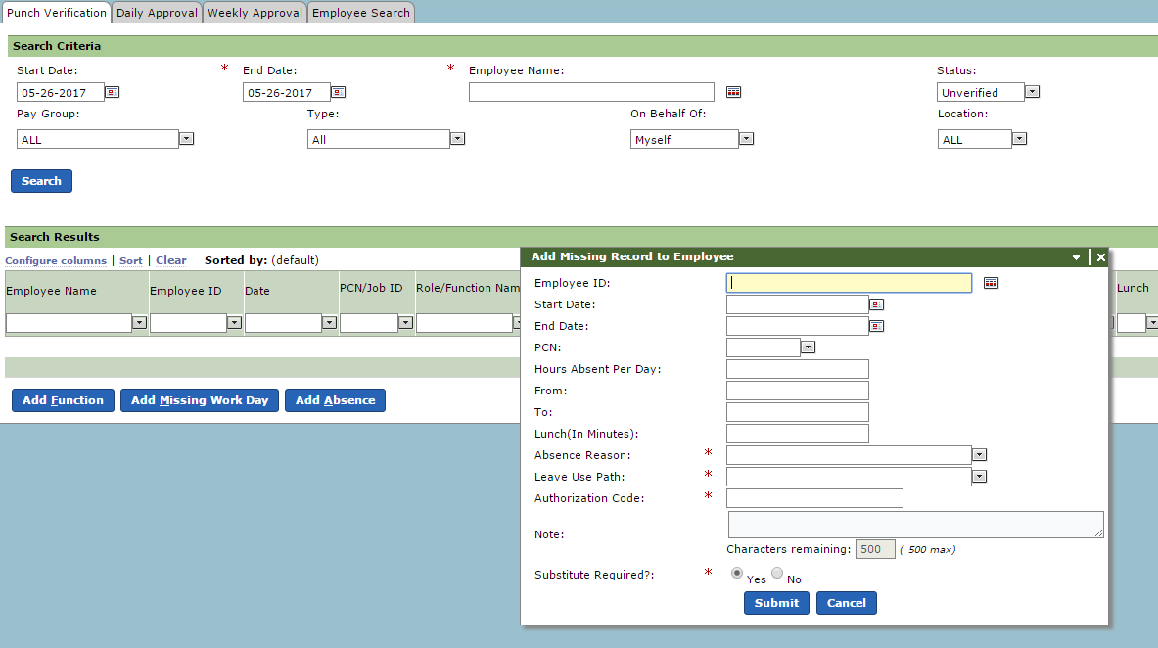
Add An Absence To A Time Card
To add Absence:
Select Punch Verification tab / Click Add Absence (it is not necessary to complete the information in search criteria).
Note: If an employee’s name is highlighted prior to the selecting the Add Absence button the Employee ID and Date fields will pre-populate.
Select the Button Add Absence
Complete the employee ID
Start Date
End Date will auto populate with same date
PCN: Automatically populates
Hours Absent per Day = number hours absent
From: If a designated time
To: If a designated time Lunch (in Minutes)
Absence Reason: Use from drop down
Leave Use Path: Auto populates to Default
Notes:
Enter any reason up to 500 characters
Substitute Required? Select Yes or No
Submit

Slide 14
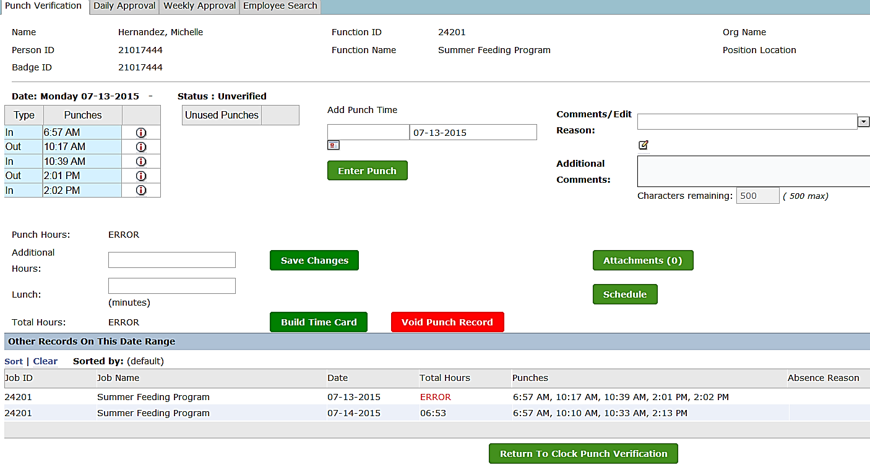
Punch Verification Details
Punches – Displays the type (In/Out), the punch times and an ‘info’ icon that, when hovered over, shows the terminal description and terminal ID of where the punch originated from.
Unused Punches – Displays any punches that are not going to be used. They do not count toward the day’s total hours. When editing a record, if there is an extra or incorrect punch that needs to be removed from the Punches list you will drag and drop that punch record to the Unused Punches section and Save Changes. If there is a punch in the Unused Punches section that needs to be added back to the Punches list, you will drag and drop that record back to the Punches list and Save Changes. The times will automatically re-order themselves in chronological order.
Add Punch Time – Used to add missing punches or enter a time correction. To add a punch, type in the desired time and select the Enter Punch button. The new punch time will be placed in the Punches list in the correct chronological order.
Punch Hours – The sum of all Punches
Additional Hours – For entering time without creating punches (this option is not recommended for use; always enter individual time punches)
Lunch – Entry for deducting lunch break (enter time in minutes)
Total Hours - The sum of (Punch Hours + Additional Hours) – Lunch. Rounding is applied here
Schedule Hours – The schedule hours for that job for that date
Build Time – Must select Build Time Card if work hours are over the standard Business Rule
Employees can see what is written here
Drag and drop incorrect punches to the Unused Punches section, then save changes and build time card
To bring back Voided punches click the Save Changes button and the punches will reappear as Unverified under Search Results on the Punch Verification Tab
Document reason for editing or adding record
VOID PUNCH RECORD--Sets the record to VOID and it will not be used to build a time

Slide 15
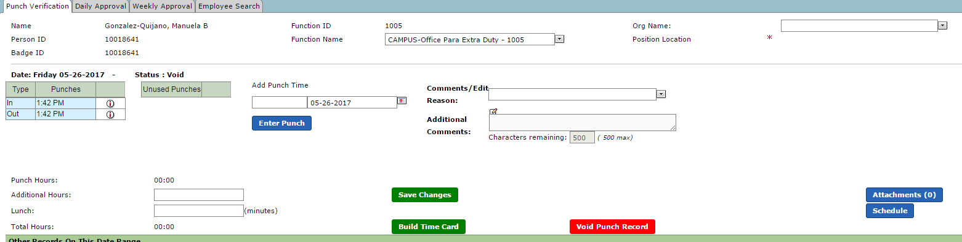
Punch Verification Details How to change a Function Name / Organization Location
If a Function used needs to be changed or Organization needs to be changed… you can change the Function name using the punch verification details screen.
Use the Drop down to select correct Function. Also, the Organization/location can be changed.
Use the Drop down to select correct Organization/location. After a change, you must select Save Changes to be effective… Be sure to have documentation of why the Function or Organization was changed.
Communicate with the appropriate personnel and notify them of the change.

Slide 16
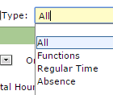
Time Card
Weekly Approval Tab
Weekly Approval should be performed by the appropriate personnel - WEEKLY
Filter criteria:
Week Ending: equals ANY Friday
Type: All/Functions/Regular Time or Absence
My Status: Approved / Pending / All
Employee Name: Leave blank for All

Slide 17
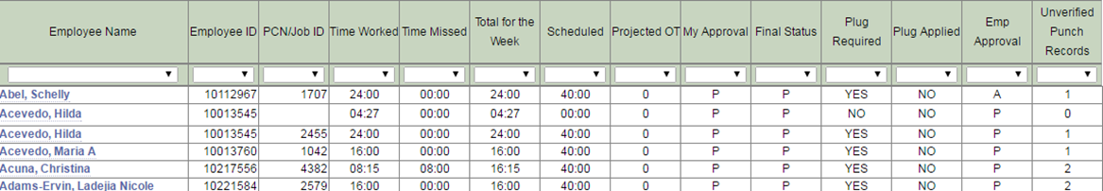
Time Card
Weekly Approval Tab – Cont.
Time Worked = Actual hours worked
Time Missed = Absent hours entered
Total for the Week = Time worked plus Time Missed
Scheduled = Hours expected to work per calendar
If Total for the Week is less than Scheduled, then there should be Absence entered in to ESC to make up the hours difference.
Legend:
A = Approved
P = Pending
My Approval = Time card builder/ Time keeper
Final Status = Principal / Supervisor of Department
Plug Required = Time is missing
Employee Approval = Employee has or has not approved their time card
Unverified Punch Records – Indicates not all time cards are built – need to be verified

Slide 18
How Can WE Assist You?
Email:
payroll@desotoisd.org

Slide 19
Payroll and Benefits Specialist Team
Tracie Cook
Loran Butler
Crystal Reed
Carmen McClendon

Slide 20
Thank You

